Slide 1
DATA ANALYSIS-intern

Slide 2
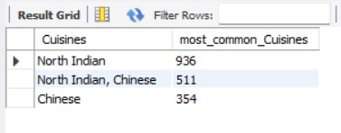
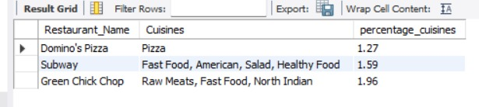
Level 1:
Task 1 – Top Cuisines Analysis
Identified the top three most common cuisines served across all restaurants.
CODE
select Cuisines,count(Cuisines) as most_common_Cuisines from dataset group by Cuisines order by most_common_Cuisines desc limit 3;
RESULT
Calculated the percentage share of each top cuisine to understand popularity.
CODE
WITH cte AS (SELECT Restaurant_Name,COUNT(*) AS no_of_orders FROM dataset GROUP BY Restaurant_Name), cuisine_counts AS (SELECT Restaurant_Name,Cuisines,COUNT(*) AS cuisine_orders FROM dataset GROUP BY Restaurant_Name, Cuisines) SELECT cc.Restaurant_Name,cc.Cuisines,ROUND(100.0 * cc.cuisine_orders / c.no_of_orders, AS percentage_cuisines FROM cuisine_counts cc JOIN cte c ON cc.Restaurant_Name = c.Restaurant_Name ORDER BY percentage_cuisines asc LIMIT 3;
RESULT

Slide 3
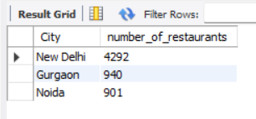
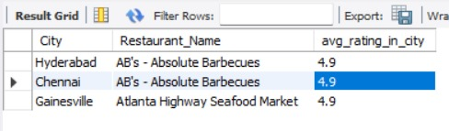
Level 1:
Task 2 – City Analysis
Identify the city with the highest number of restaurants in the dataset.
CODE
select City,count(distinct Restaurant_Name)as number_of_restaurants from dataset group by City order by number_of_restaurants desc limit 3;
RESULT
Calculate the average rating for restaurants in each city.
CODE
SELECT City,Restaurant_Name,ROUND(AVG(Aggregate_rating), 1) AS avg_rating_in_city FROM datasetGROUP BY City, Restaurant_Name ORDER BY avg_rating_in_city DESC, Restaurant_Name limit 3;
RESULT

Slide 4
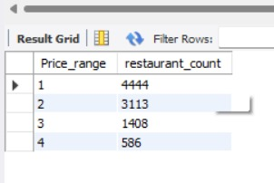
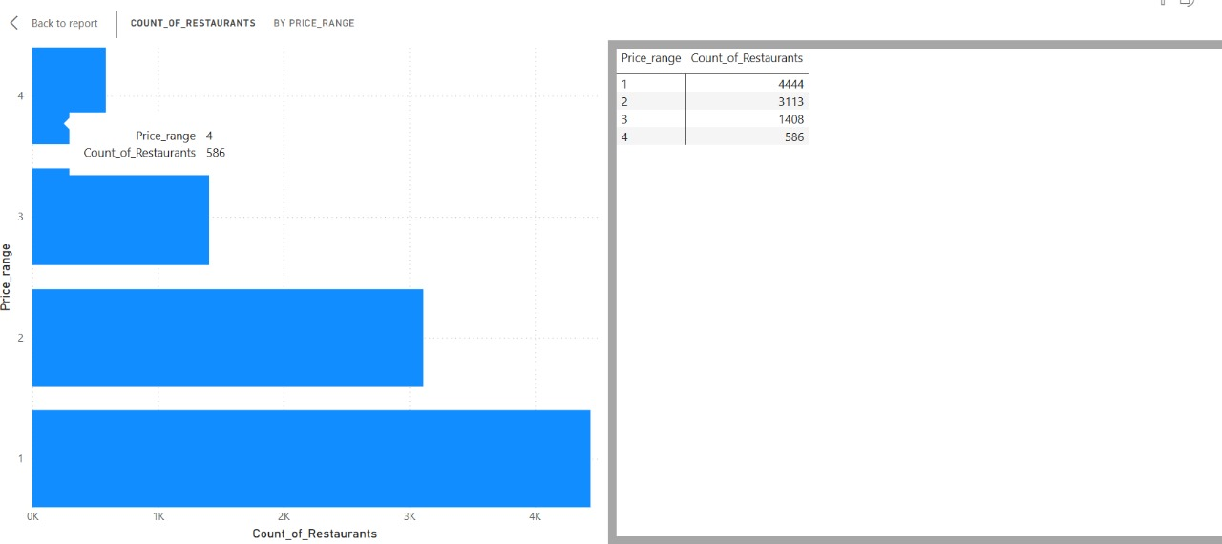
Level 1:
Task 3 – Price Range Distribution
Create a histogram or bar chart to visualize the distribution of price ranges among the restaurants.
CODE
SELECT Price_range, COUNT(*) AS restaurant_count FROM dataset GROUP BY Price_range order by Price_range ;
RESULT

Slide 5
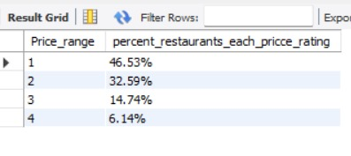
Level 1:
Task 3 – Price Range Distribution
Calculate the percentage of restaurants in each price range category.
CODE
select Price_range, concat(round(100.00*count()/(select count() from dataset),2),'%') as percent_restaurants_each_pricce_rating from dataset group by Price_range order by Price_range asc;
RESULT

Slide 6
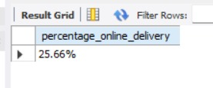
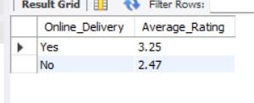
Level 1:
Task 4– Online Delivery
Determine the percentage of restaurants that offer online delivery.
CODE
select concat(round(100.00*count()/(select count() from dataset),2),'%') as percentage_online_delivery from dataset where Has_Online_delivery='Yes‘;
RESULT
Compare the average ratings of restaurants with and without online delivery.
CODE
SELECT 'Yes' AS Online_Delivery, round(AVG(Aggregate_rating),2) AS Average_Rating FROM dataset WHERE Has_Online_delivery = 'Yes‘ UNION ALL SELECT 'No' AS Online_Delivery, round(AVG(Aggregate_rating),2) AS Average_Rating FROM dataset WHERE Has_Online_delivery = 'No';
RESULT

Slide 7
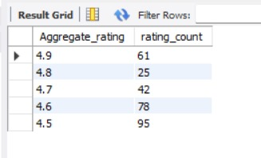
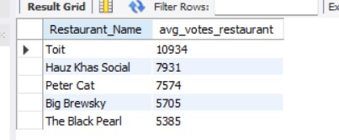
Level 2:
Task 1 – Restaurant Ratings
Analyze the distribution of aggregate ratings and determine the most common rating range.
CODE
SELECT Aggregate_rating, COUNT(*) AS rating_count FROM dataset WHERE Aggregate_rating > 0 GROUP BY Aggregate_rating ORDER BY Aggregate_rating desc,rating_count DESC limit 5;
RESULT
Calculate the average number of votes received by restaurants.
CODE
select Restaurant_Name, round(avg(Votes),0) as avg_votes_restaurant from dataset group by Restaurant_Name order by avg_votes_restaurant desc limit 5;
RESULT

Slide 8
Level 2:
Task 2–Cuisine Combination
Identify the most common combinations of cuisines in the dataset.
CODE
SELECT Aggregate_rating, COUNT(*) AS rating_count FROM dataset WHERE Aggregate_rating > 0 GROUP BY Aggregate_rating ORDER BY Aggregate_rating desc,rating_count DESC limit 5;
RESULT
Calculate the average number of votes received by restaurants.
CODE
select Restaurant_Name, round(avg(Votes),0) as avg_votes_restaurant from dataset group by Restaurant_Name order by avg_votes_restaurant desc limit 5;
RESULT

Slide 9
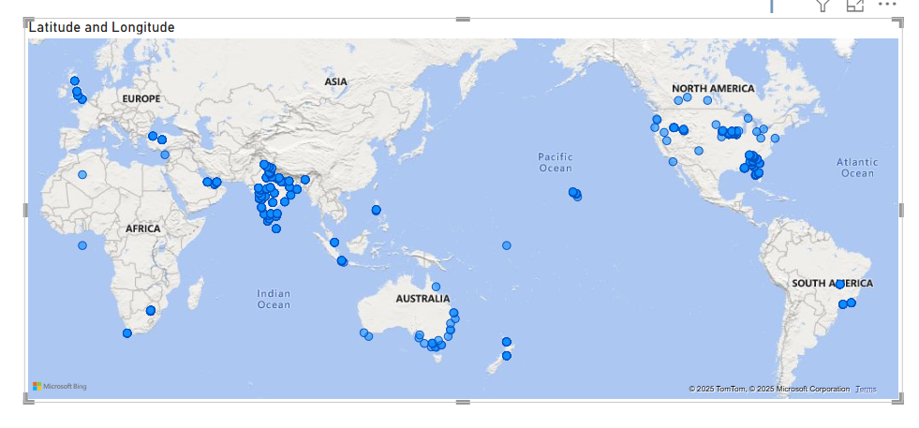
Level 2:
Task 3 – Geographic Analysis
Plot the locations of restaurants on a map using longitude and latitude coordinates.

Slide 10
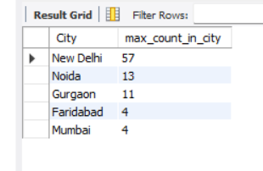
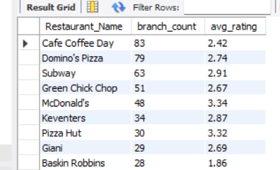
Level 2:
Task 4: Restaurant Chains
Identify if there are any restaurant chains present in the dataset.
CODE
with cte as (SELECT Restaurant_Name, City, COUNT(*) AS count_in_city FROM dataset GROUP BY Restaurant_Name, City HAVING COUNT(*) > 1 ORDER BY count_in_city DESC) select City,Max(count_in_city) as max_count_in_city from cte group by City limit 5;
RESULT
Analyze the ratings and popularity of different restaurant chains.
CODE
SELECT Restaurant_Name,COUNT(*) AS branch_count, ROUND(AVG(Aggregate_rating), 2) AS avg_rating FROM dataset GROUP BY Restaurant_Name HAVING COUNT(*) > 1 -- Indicates it's a chain ORDER BY branch_count DESC;
RESULT

Slide 11
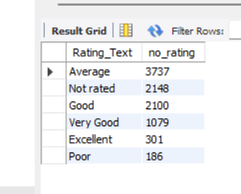
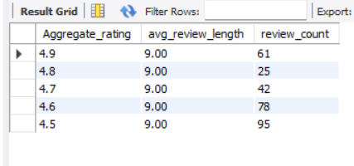
Level 3:
Task 1: Restaurant Reviews
Analyze the text reviews to identify the most common positive and negative keywords.
CODE
select Rating_Text, count(Rating_Text) as no_rating from dataset group by Rating_Text order by no_rating desc;
RESULT
Calculate the average length of reviews and explore if there is a relationship between review length and rating.
CODE
SELECT Aggregate_rating,ROUND(AVG(CHAR_LENGTH(Rating_text)), 2) AS avg_review_length, COUNT(*) AS review_count FROM dataset WHERE Rating_text IS NOT NULL AND Rating_text != ‘ ’ GROUP BY Aggregate_rating ORDER BY Aggregate_rating DESC,review_count desc limit 5;
RESULT

Slide 12
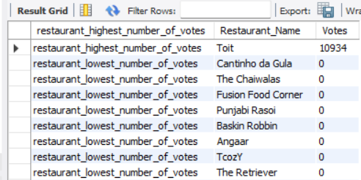
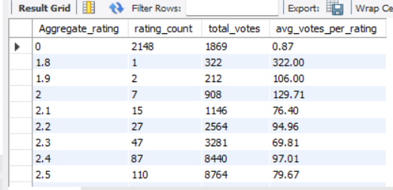
Level 3:
Task 2:Votes Analysis
Identify the restaurants with the highest and lowest number of votes.
CODE
SELECT 'restaurant_highest_number_of_votes', Restaurant_Name, Votes FROM dataset WHERE Votes = (SELECT MAX(Votes) FROM dataset) union all SELECT 'restaurant_lowest_number_of_votes', Restaurant_Name, Votes FROM dataset WHERE Votes = (SELECT min(Votes) FROM dataset);
RESULT
Analyze if there is a correlation between the number of votes and the rating of a restaurant.
CODE
SELECT Aggregate_rating,COUNT(*) AS rating_count, SUM(Votes) AS total_votes, ROUND(AVG(Votes), 2) AS avg_votes_per_rating FROM dataset GROUP BY Aggregate_rating ORDER BY Aggregate_rating;
RESULT

Slide 13
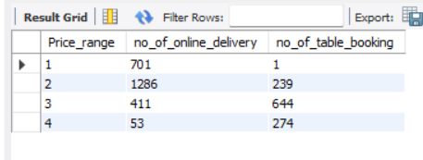
Level 3:
Task 3:Price Range vs. Online Delivery and Table Booking
Analyze if there is a relationship between the price range and the availability of online delivery and table booking.
CODE
SELECT d.Price_range, COUNT(CASE WHEN Has_online_delivery = 'Yes' THEN 1 END) AS no_of_online_delivery, COUNT(CASE WHEN Has_Table_booking = 'Yes' THEN 1 END) AS no_of_table_booking FROM dataset as d GROUP BY d.Price_range ORDER BY d.Price_range;
RESULT

Slide 14
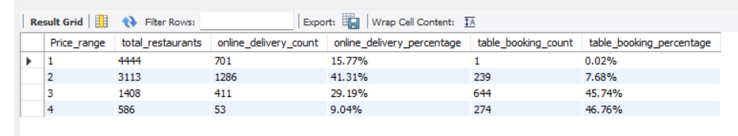
Task 3:Price Range vs. Online Delivery and Table Booking
Determine if higher-priced restaurants are more likely to offer these services.
CODE
SELECT Price_range,COUNT(*) AS total_restaurants, COUNT(CASE WHEN Has_online_delivery = 'Yes' THEN 1 END) AS online_delivery_count, concat(ROUND(100.0 * COUNT(CASE WHEN Has_online_delivery = 'Yes' THEN 1 END) / COUNT(*), 2),'%') AS online_delivery_percentage, COUNT(CASE WHEN Has_Table_booking = 'Yes' THEN 1 END) AS table_booking_count, concat(ROUND(100.0 * COUNT(CASE WHEN Has_Table_booking = 'Yes' THEN 1 END) / COUNT(*), 2),'%') AS table_booking_percentage FROM dataset GROUP BY Price_range ORDER BY Price_range;
RESULT

